Slide 1

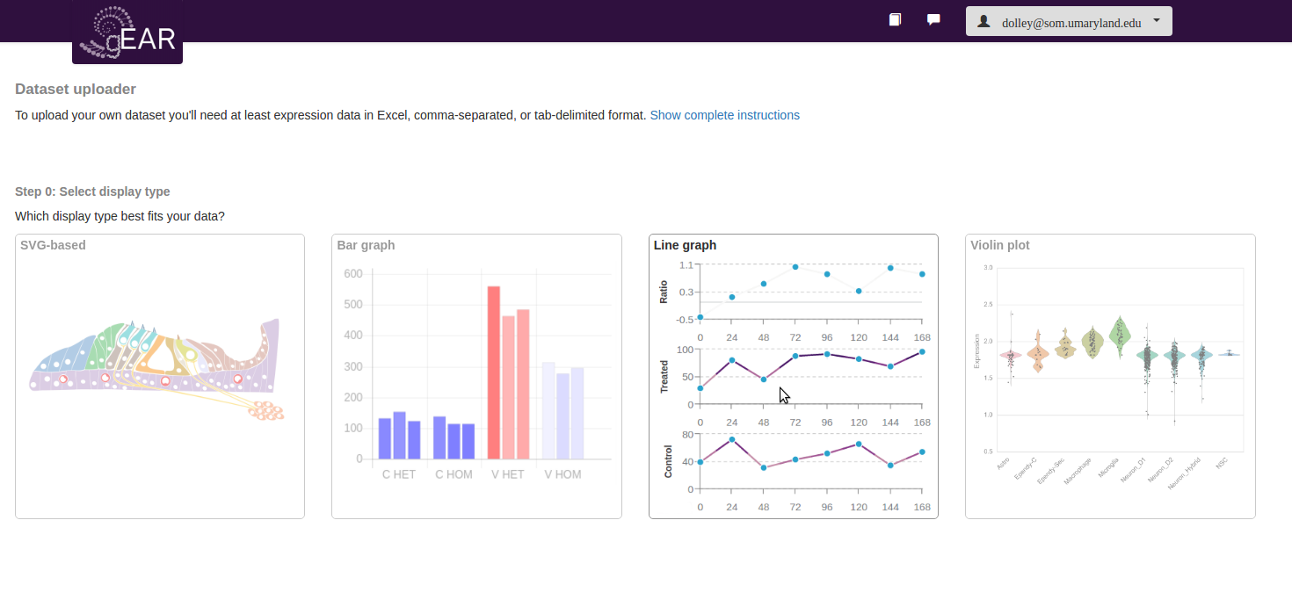
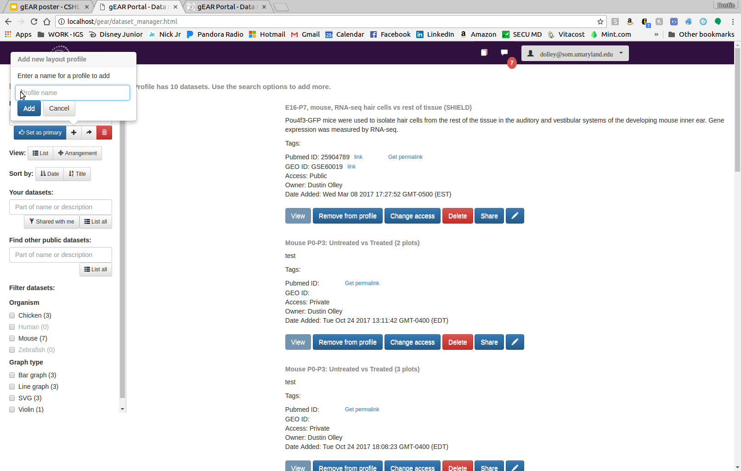
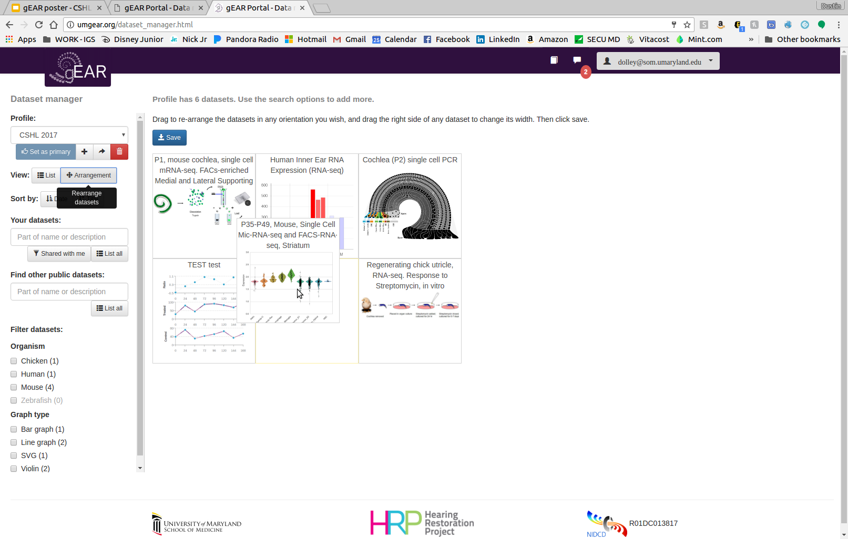
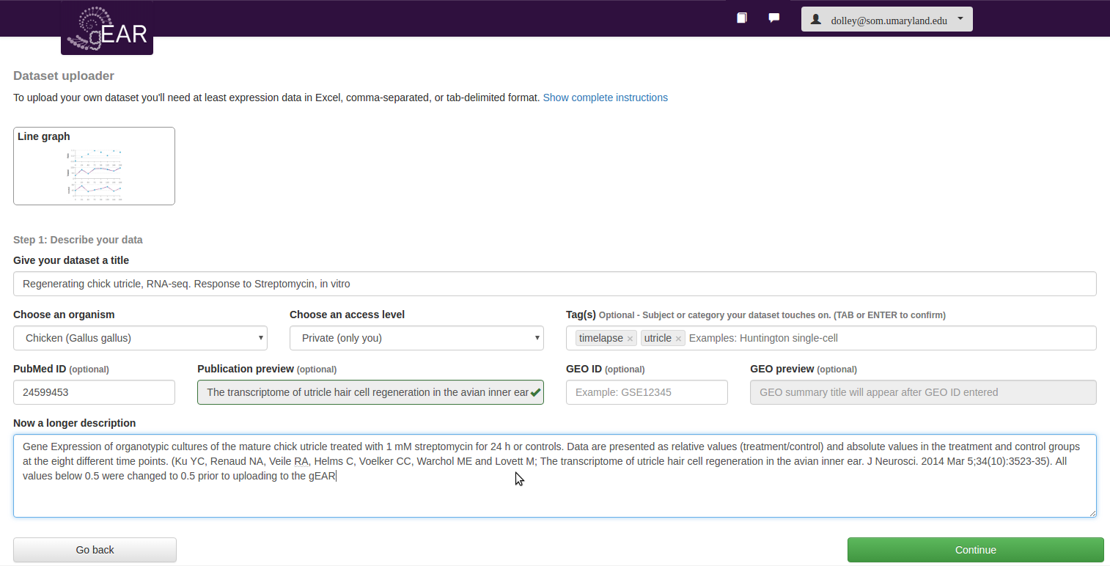
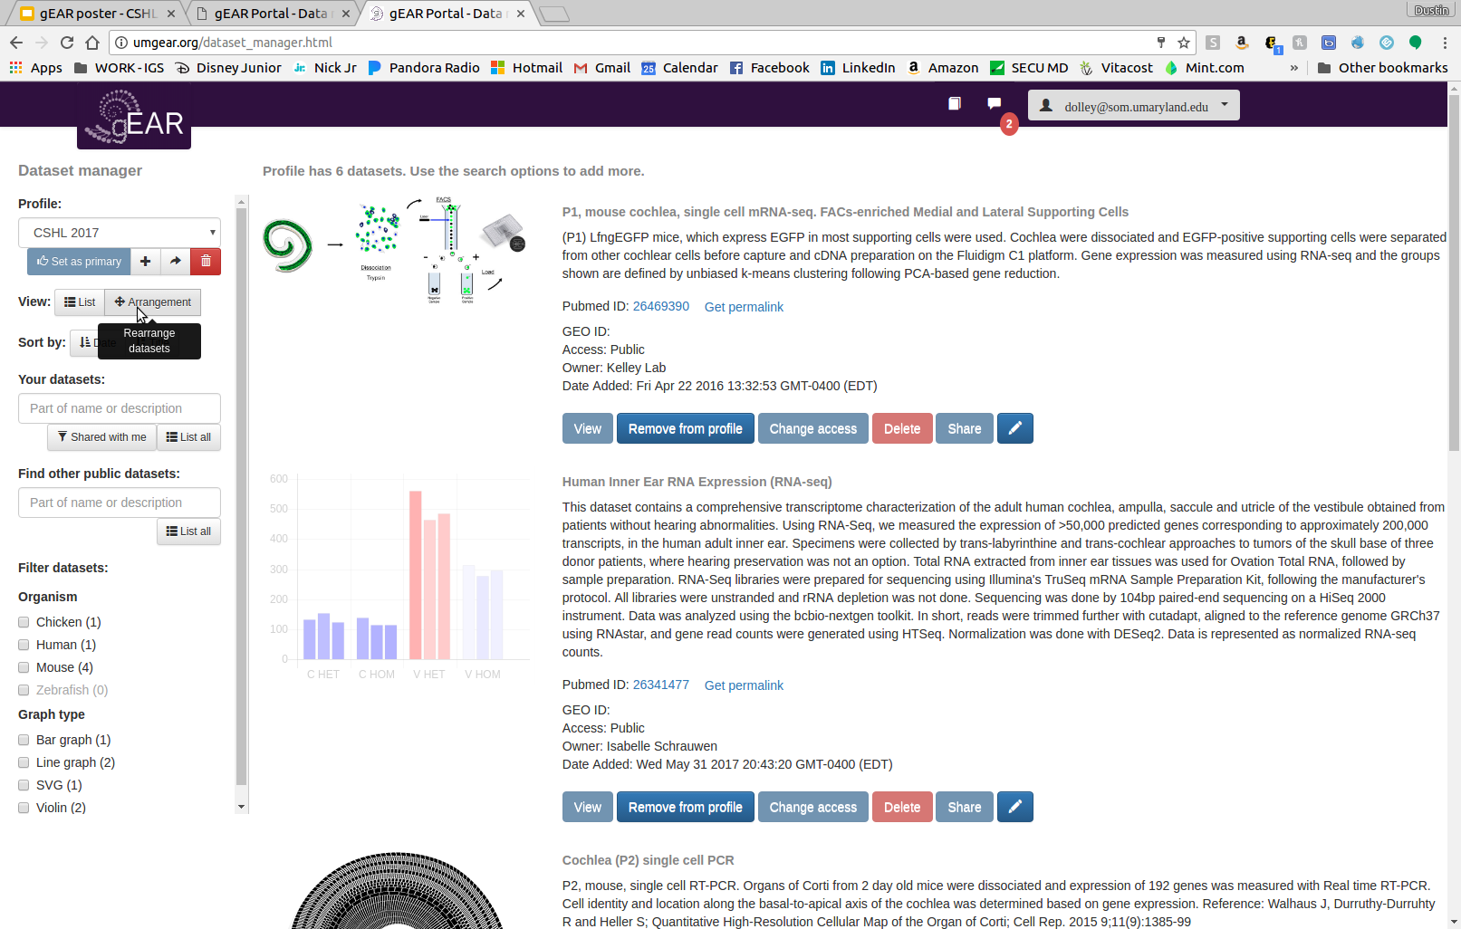
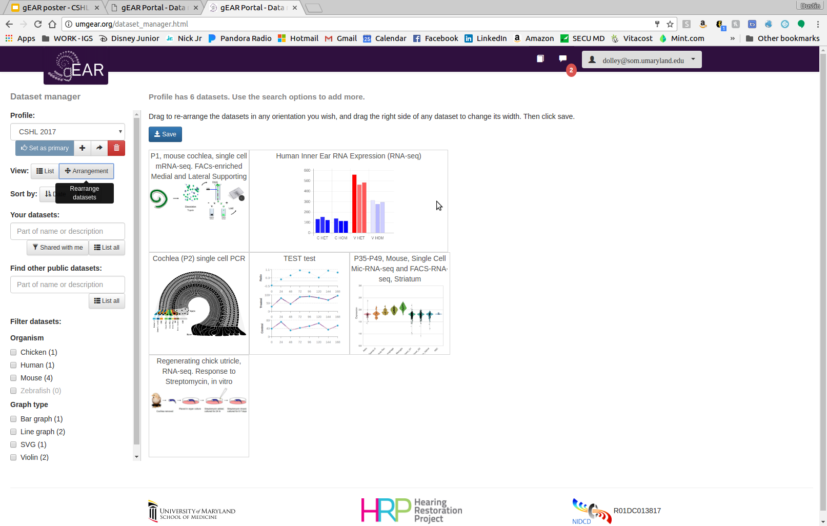
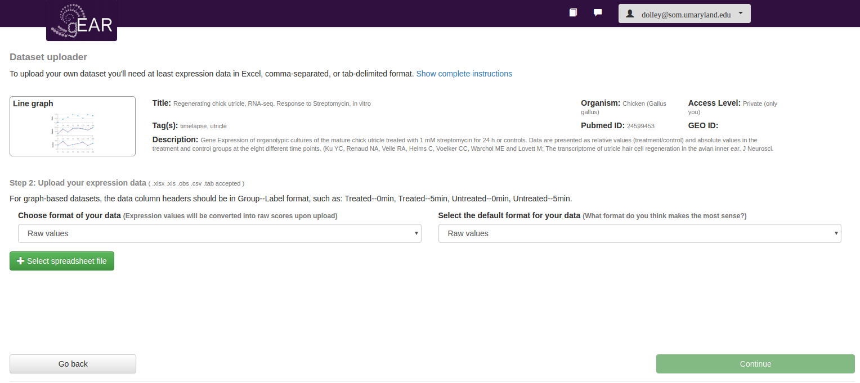
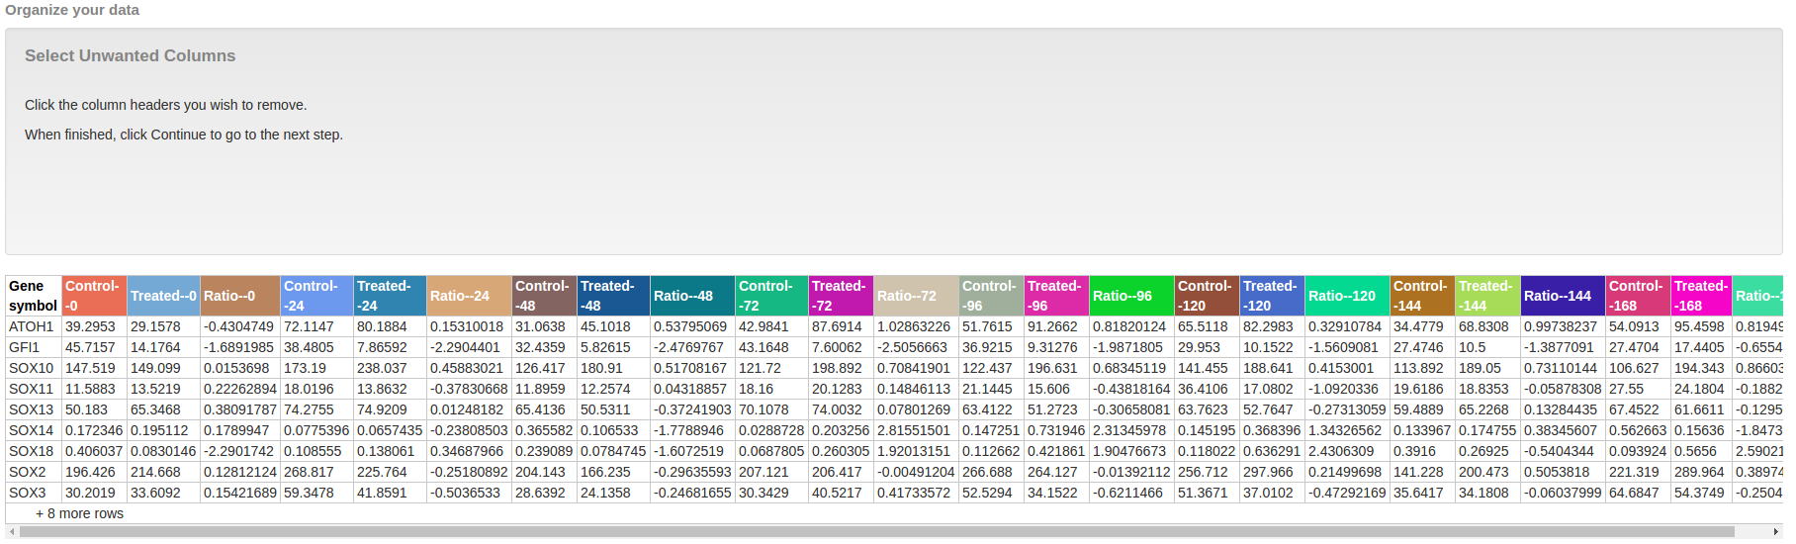
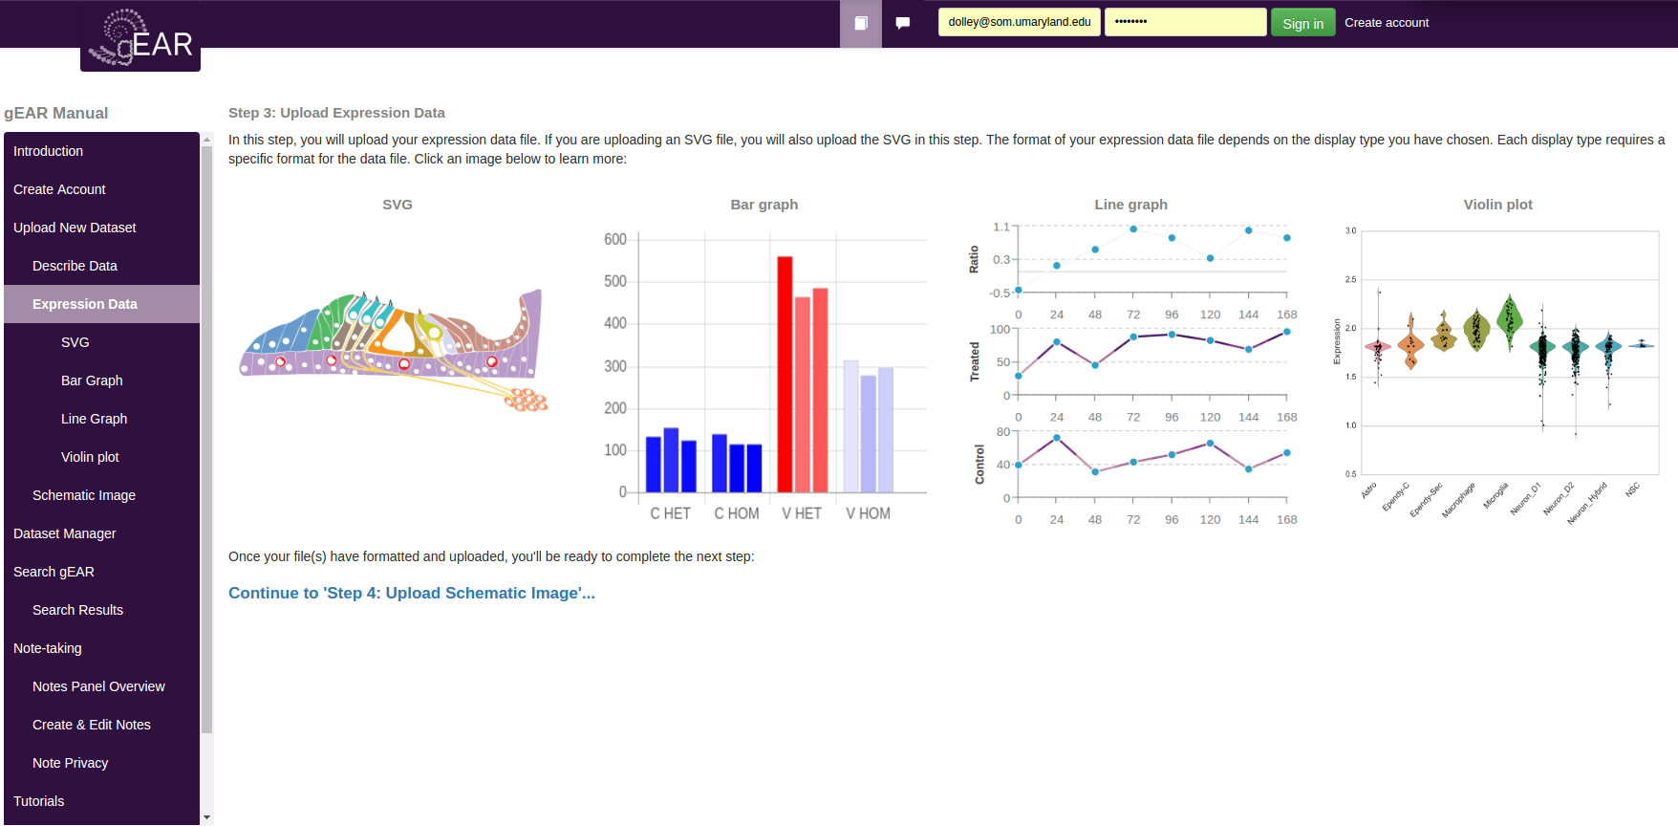
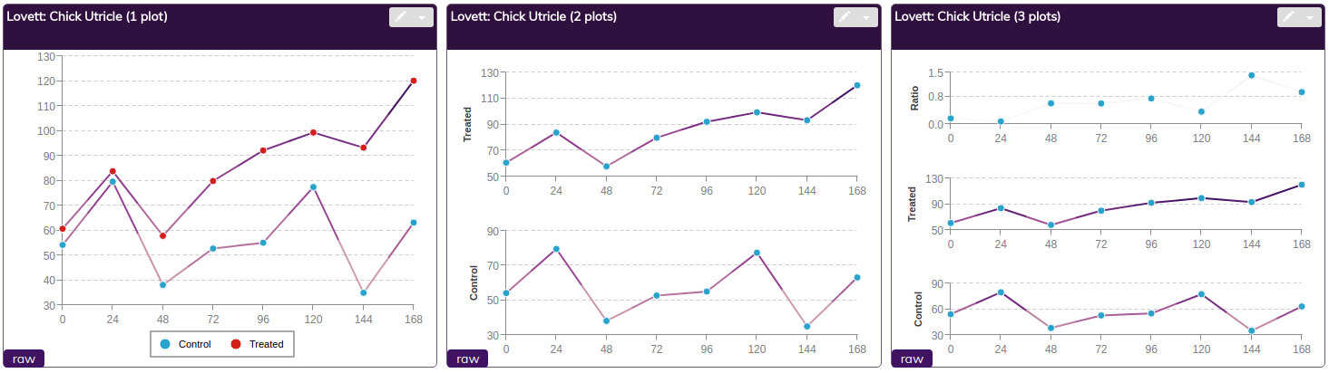
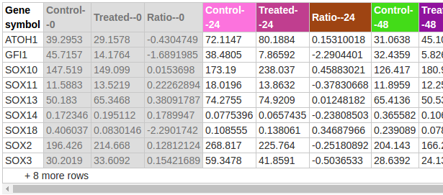
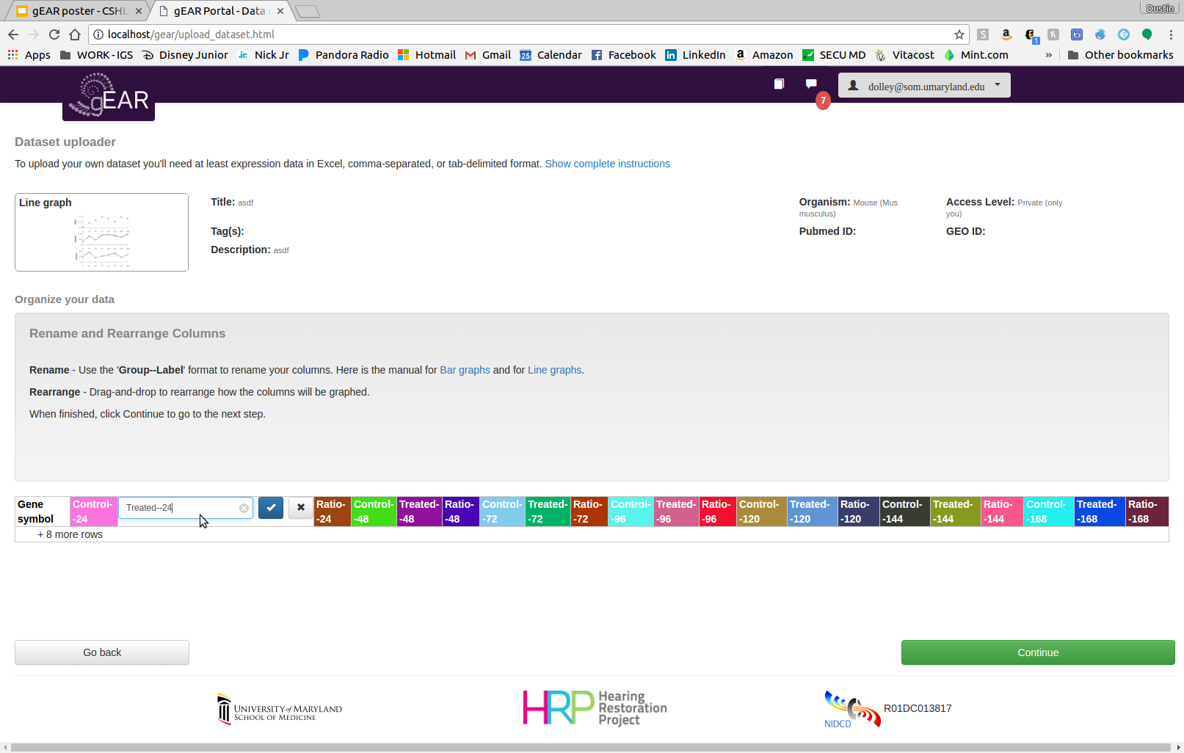
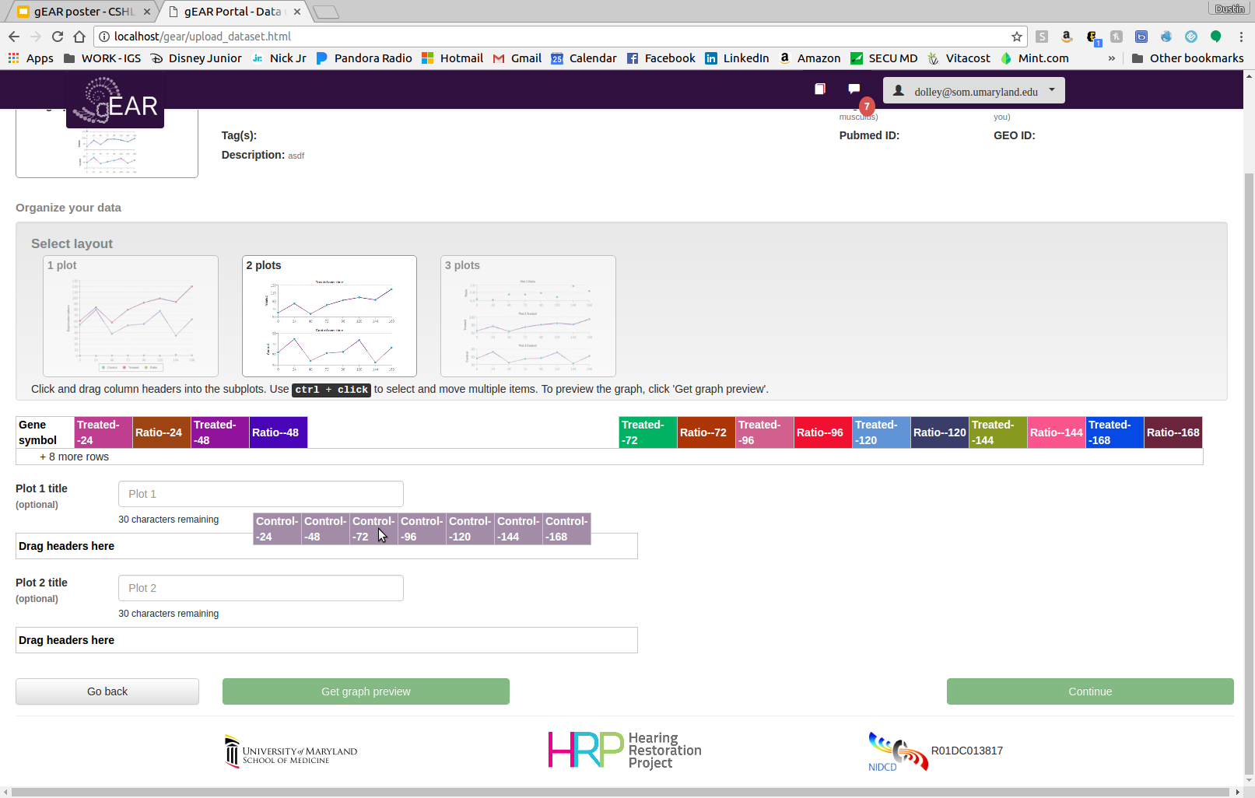
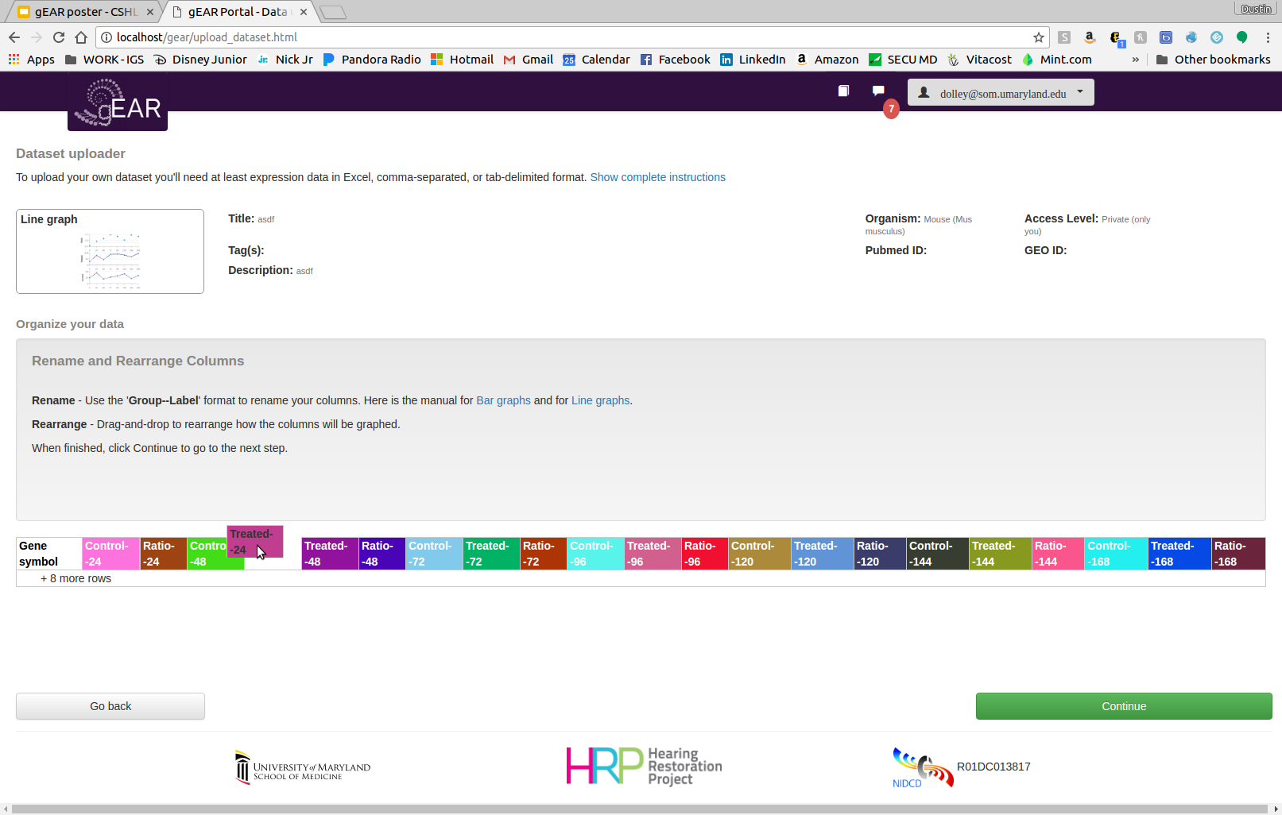
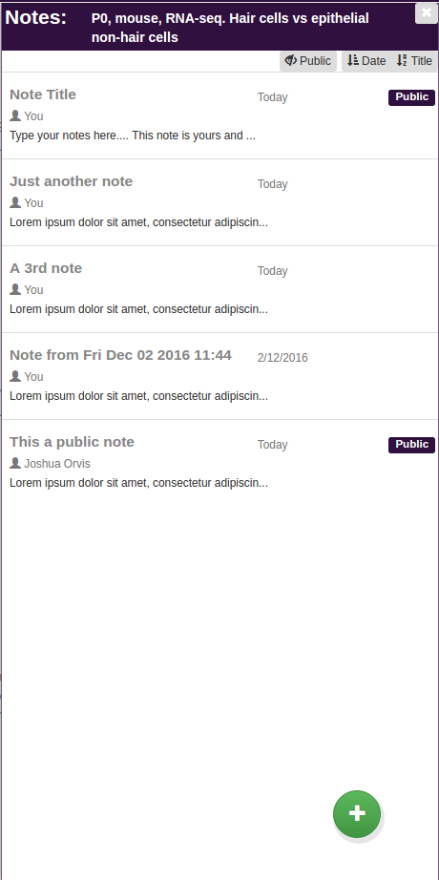
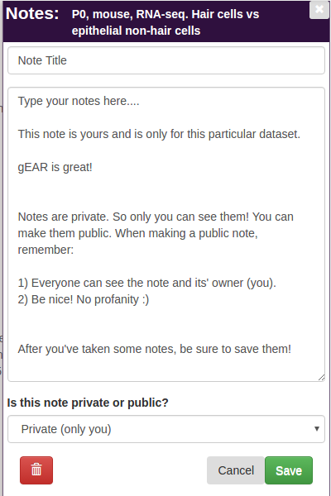
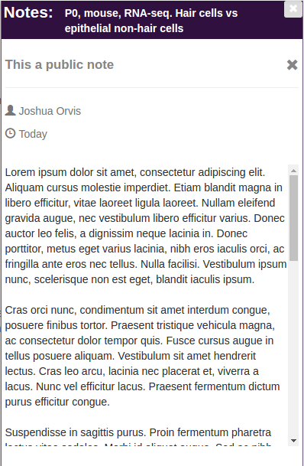
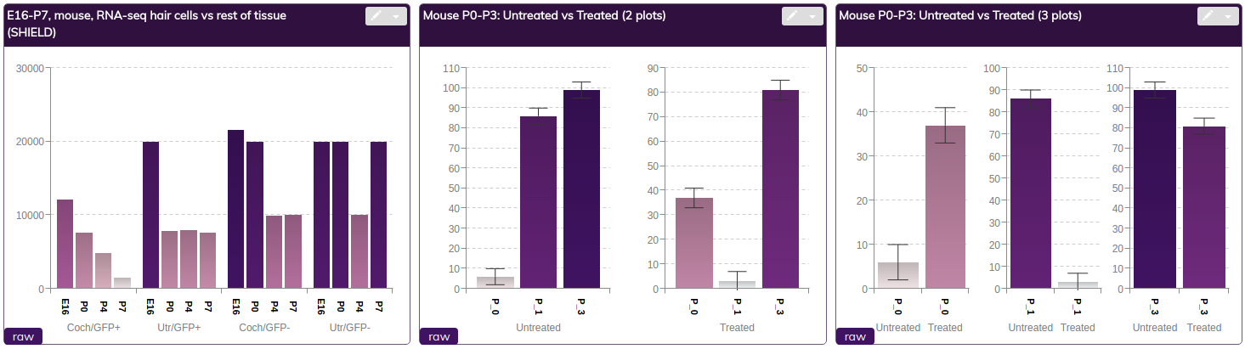
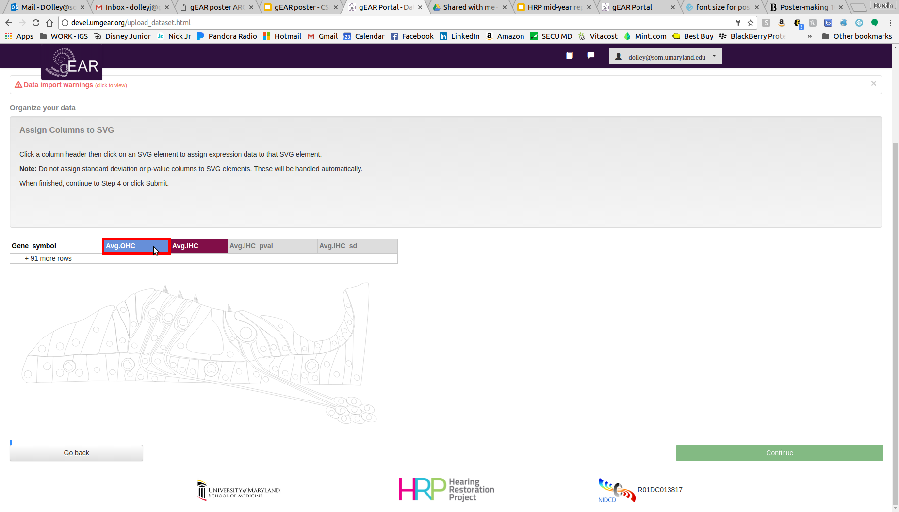
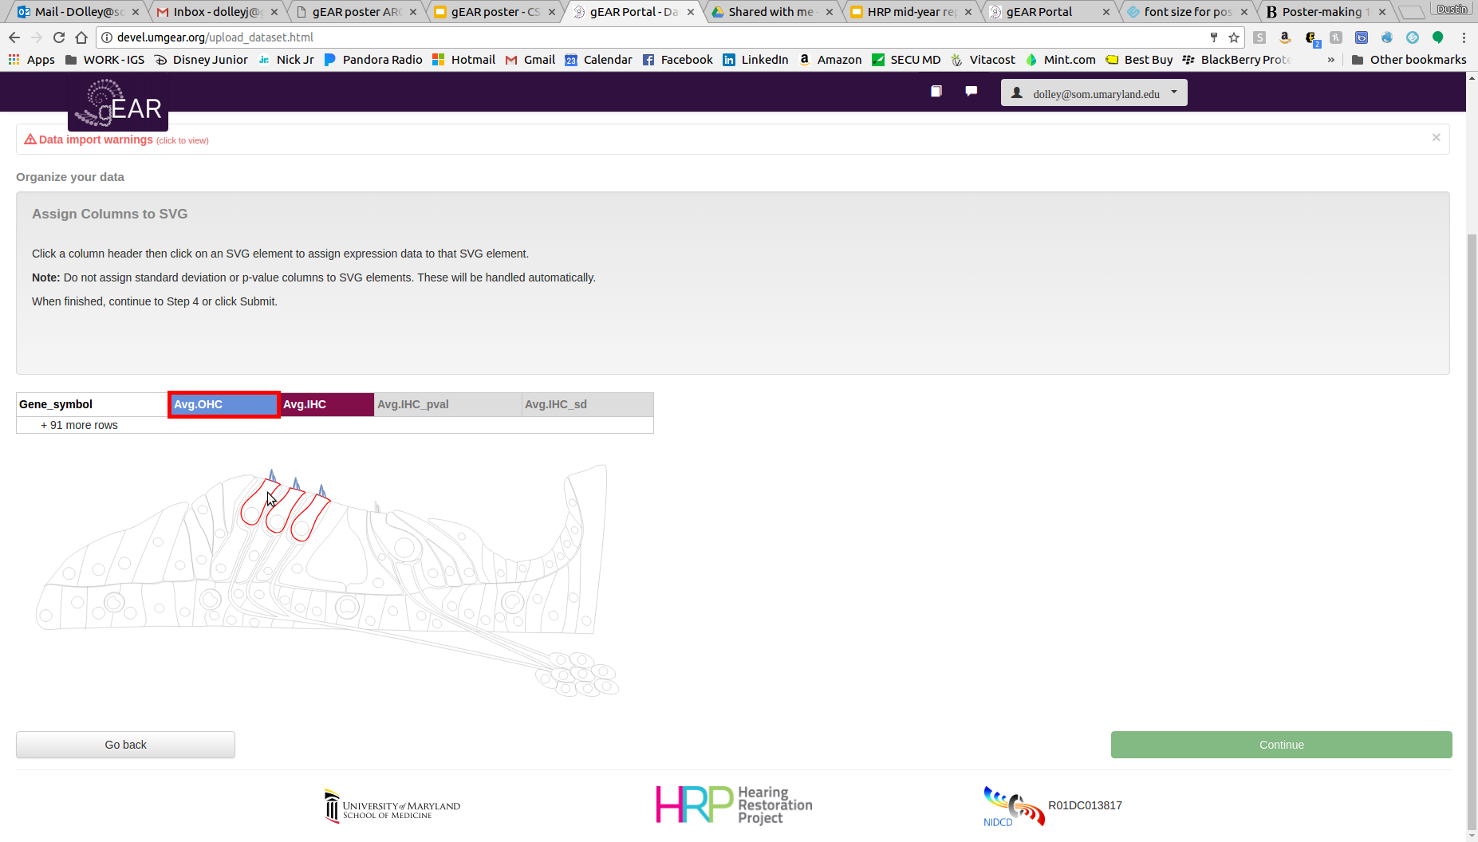
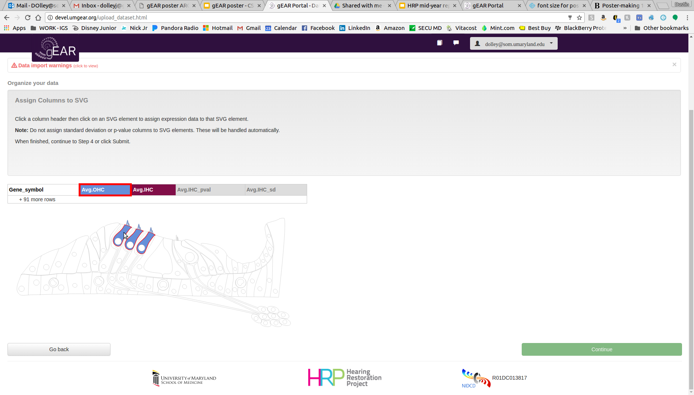
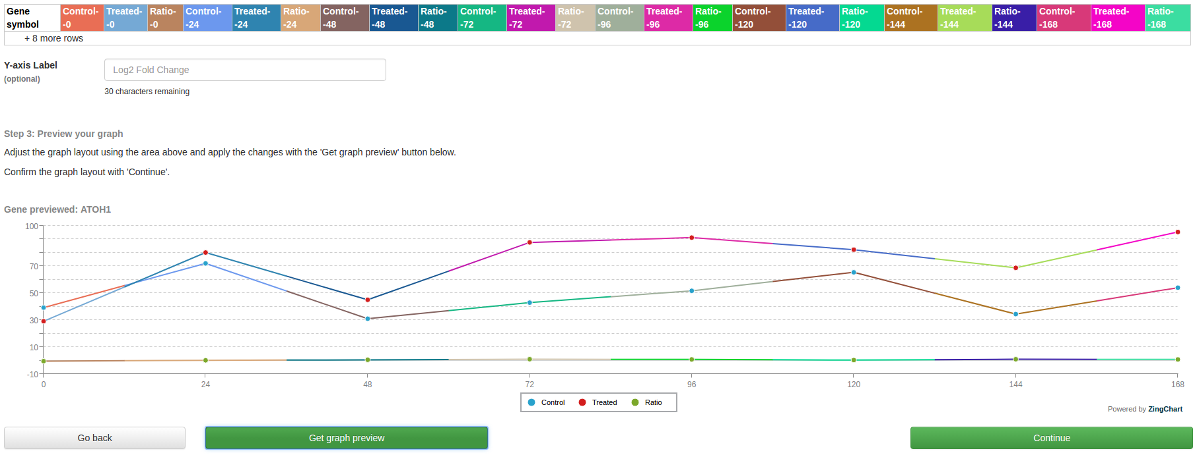
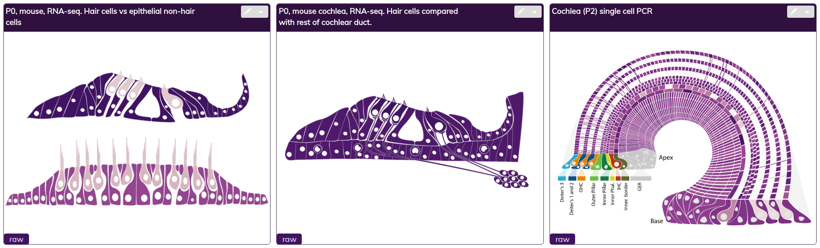
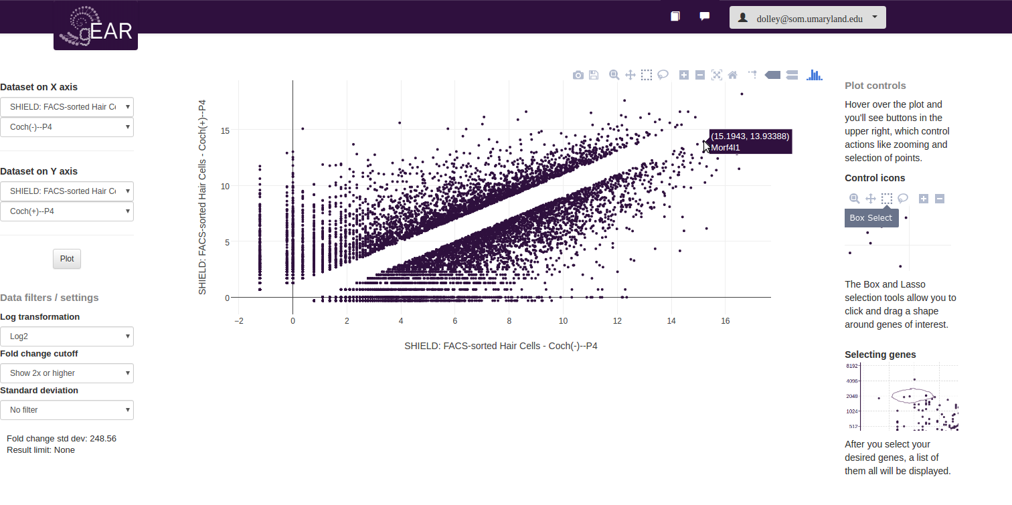
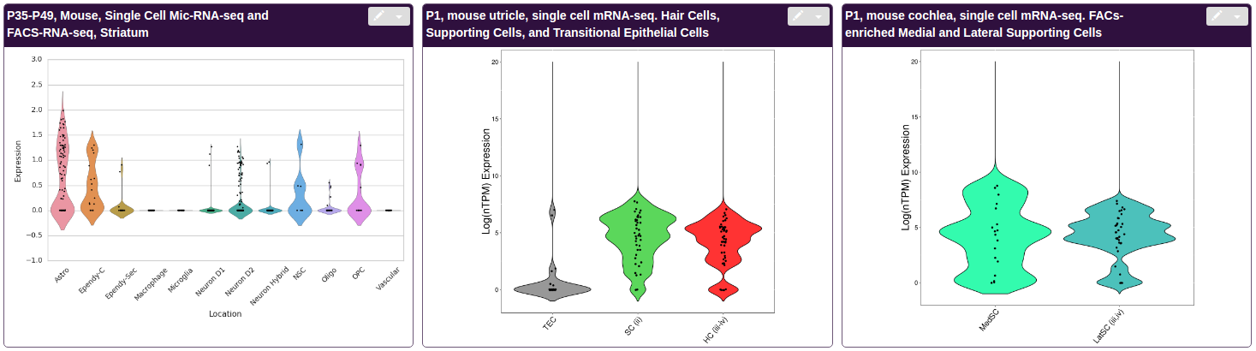
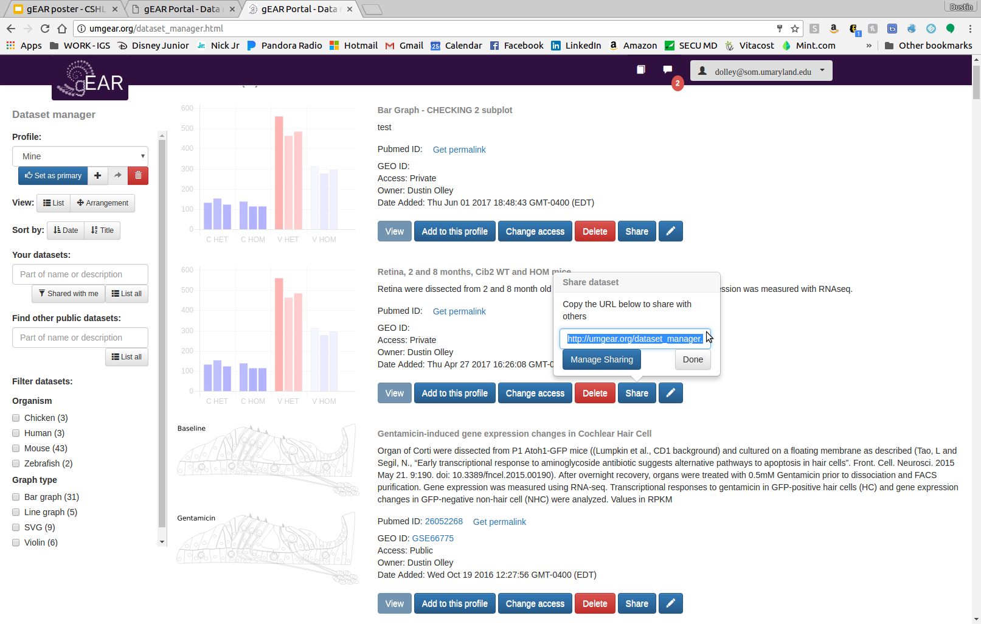
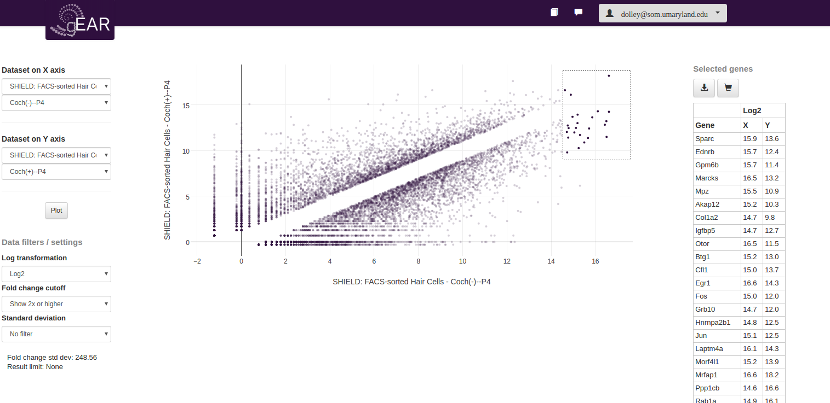
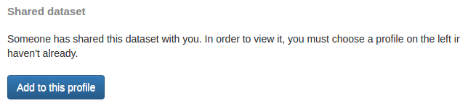
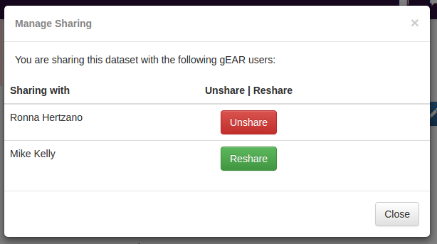



The gEAR portal—Sharing and displaying gene expression now simplified and diversified
Joshua D Orvis¹, Dustin J Olley¹, Amiel Dror², Michael Kelly³, Anup A. Mahurkar¹, Ronna Hertzano^{1,3,4} Affiliations: ¹Institute for Genome Sciences, University of Maryland School of Medicine; ²Department of Human Molecular Genetics and Biochemistry, Tel Aviv University; ³National Institutes of Health, NIDCD, Bethesda, MD; ⁴Departments of Otorhinolaryngology Head & Neck Surgery and ⁵Anatomy and Neurobiolology, University of Maryland School of Medicine.
Next generation sequencing as a tool for recording gene expression has increased in popularity over the past decade, now extending also to single cell RNA-seq. While tissue processing, library preparation and sequencing are now both faster and more affordable, data sharing and visualization remain challenging. We previously introduced the gEAR portal (gene Expression Analysis Resource) as a website for dissemination, presentation and cross-comparison of cell type-specific gene expression in the public domain. Since its conception, the gEAR has evolved to allow many new features, including: 1) multiple forms of data visualization (graph, SVG-coloring and violin plots); 2) a user-friendly data uploader; 3) uploaded data can now remain private and viewed in the context of the public datasets, or be posted for sharing publically; 4) private data sharing with collaborators is now possible through unique links; 5) monitoring privacy of shared data; 6) customized layouts; 7) online manual and many additional features and updates. The gEAR is a home and a portal for all members of the hearing research community, but is expanding into other fields, including brain research. For those working on gene expression it allows visualization of their data in the context of other private and public datasets, including single cell RNA-seq and soon to come complex data-query. For all other researchers, the gEAR is an ever updating portal answering questions from as simple as ‘where is this gene expressed in the ear’ to ‘how does it change in published datasets’ and also offers direct links to a variety of resources. The gEAR portal is publically available and can be accessed through umgear.org
User-friendly Data Uploader
Customized Dataset Layouts
The data uploader has been greatly improved to provide a better user experience.
Custom layouts let you decide what datasets to search, and arrange your layout profile how you want it. The order and width of the datasets can be changed in a custom layout.
1 - Choose display type
1 - Add New Layout
3 - Rearrange Datasets
Select a display type that will best represent your data.
Create a new custom layout profile.
Click and drag datasets to rearrange them.
2 - Describe your data
Add metadata, and, if available, you can link the dataset’s Pubmed ID and GEO GSE ID.
2 - Click Arrangement
4 - Resize Datasets
Rearrange and resize datasets here.
Drag the right side of datasets to resize them.
3 - Upload data file
Upload your expression data. Excel, TAB, and CSV file formats are accepted.
Online Manual and Helpdesk
4 - Organize data
Whether you are new to gEAR or a power user, the manual provides instructions and guidance on all aspects of gEAR. It is continually updated as new features are added.
If more help is needed, gEAR also has a Helpdesk, where you can get individualized assistance.
Data Visualization Types
Line graphs, bar graphs, and SVGs several organizational steps.
Currently data can be visualized in line and bar graphs, scalable vector graphics (SVG), and violin plots. Each visualization type is rendered on-the-fly to produce near instantaneous results.
Line and Bar Graph Steps
2 ) Rename and rearrange columns
1 ) Select unwanted columns
3 ) Organize subplots
Take Notes
Line and bar graphs can be split into 2 or 3 subplots. Each can include standard deviation bars. Titles can also be added for each subplot.
Take notes while querying genes. Each dataset has its’ own set of notes. Notes can be kept Private or be made Public. Public notes are visible to any user that has access to the dataset.
SVG Additional Step - SVGs have an added step of assigning data columns to SVG <path> elements.
Main notes panel
Create a note
Public note
1 ) Select column
2 ) Hover on SVG
3 ) Select column
View your notes and any public notes for that dataset.
You can filter out public notes, sort notes by title and date.
Create a new note or add to it.
Notes can be kept Private or be listed as Public for others to see.
Public notes for a dataset are only visible to users that have access to the dataset.
5 - Preview
Advanced Dataset Comparison Tool
Data columns from the expression file are assigned to <path> elements to link expression values to regions of the SVG.
Preview your bar or line graph prior to submission.
Compare conditions within a dataset or between datasets.
Collaborate Via Sharing
1 - Select X and Y axis
Sharing datasets enhances collaboration. You can share your dataset by sending a dataset unique URL to your collaborators through email or chat.
Select a dataset and condition for the X and Y axis, then plot.
Hover over a plot point to see the gene symbol.
Violin plots generally represent single-cell datasets.
Send share URL
2 - Draw to select
Your Data in Context of Others
Once collaborators follow the share URL, the dataset can be added to a profile and accessed.
Draw around your area of interest to produce a list of these genes.
The gene list can then be downloaded or saved as a gene cart.
Compare and query your data along beside other data. No other resource allows you to dynamically compare your data across datasets and organisms on-the-fly.
Add to profile
Future Directions
Monitor Privacy of Shared Data
Greater flexibility and scalability - 3-tiered code architecture with Python and R APIs
Improve access to and presentation of data
Allow for advanced queries (“Find genes with 3-fold increase in dataset X’s condition A, but have 2-fold decrease in dataset Y’s condition B”)
Add data display types, such as multi-gene violin plots and heatmaps
Greater expansion of on-the-fly analysis capabilities - K-means clustering, Hierarchical clustering, cell trails, PCA
Increase number of uploaded and curated datasets - Continue to upload and support HRP-generated and public datasets.
You can monitor and control who can access your dataset.
Unshare a dataset to revoke access to the dataset, or
Reshare it to give back access.
Visit us at
UMgEAR.org
The gEAR is funded by the Hearing Health Foundation (Hearing Restoration Project) and the NIDCD/NIH R01DC013817 (RH).

